Slide 1
Statistical Inference

Slide 2
Statistics
Statistics is a discipline that provides with a methodology allowing to make an inference from real random data on parameters of probabilistic models that are believed to generate such data.
Any number that is derived from a sample is a statistic.
Often times a statistic is trying to estimate something.
In this case the statistic is also called an estimator.

Slide 3
Statistics are Random Variables
A random variable is a rule that assigns a number to every outcome of a statistical experiment.
The statistical experiment is the process of collecting a random sample.
The rule in the experiment is the statistic.
Every random variable has a probability distribution.

Slide 4
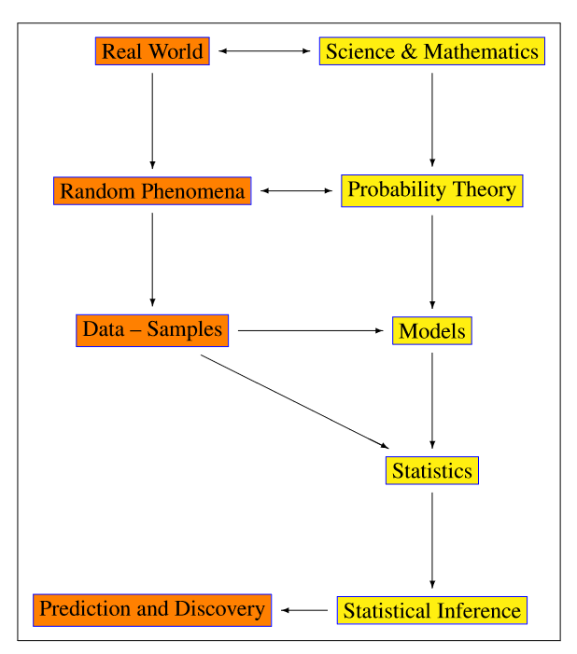
Statistical Inference in the Real World
Statistical inference is the process of deducing properties of an underlying probability distribution by analysis of data.
KRZYSZTOF PODGORSKI Department of Mathematics and Statistics University of Limerick, Ireland

Slide 5
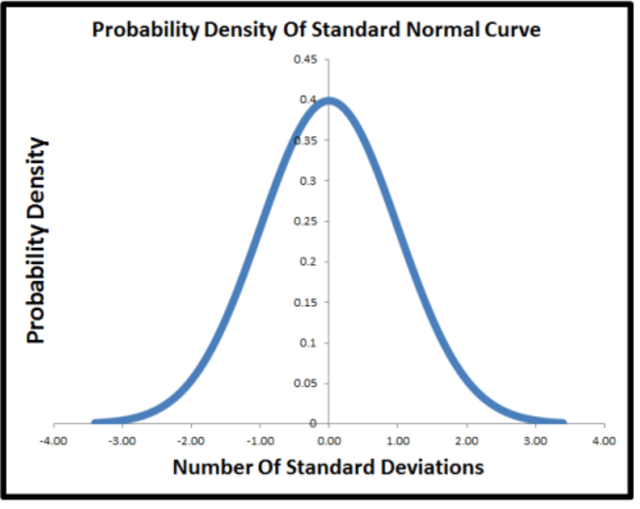
Probability Distribution of Normal Distribution

Slide 6
Sampling Distribution
A sampling distribution is simply the probability distribution of a statistic.
The sampling distribution is based upon a specific sample size, n.
The sampling distribution tell us how likely or unlikely it is to observe specific values of the statistic.

Slide 7
Sample Mean – Normally Distributed Sample

Slide 8
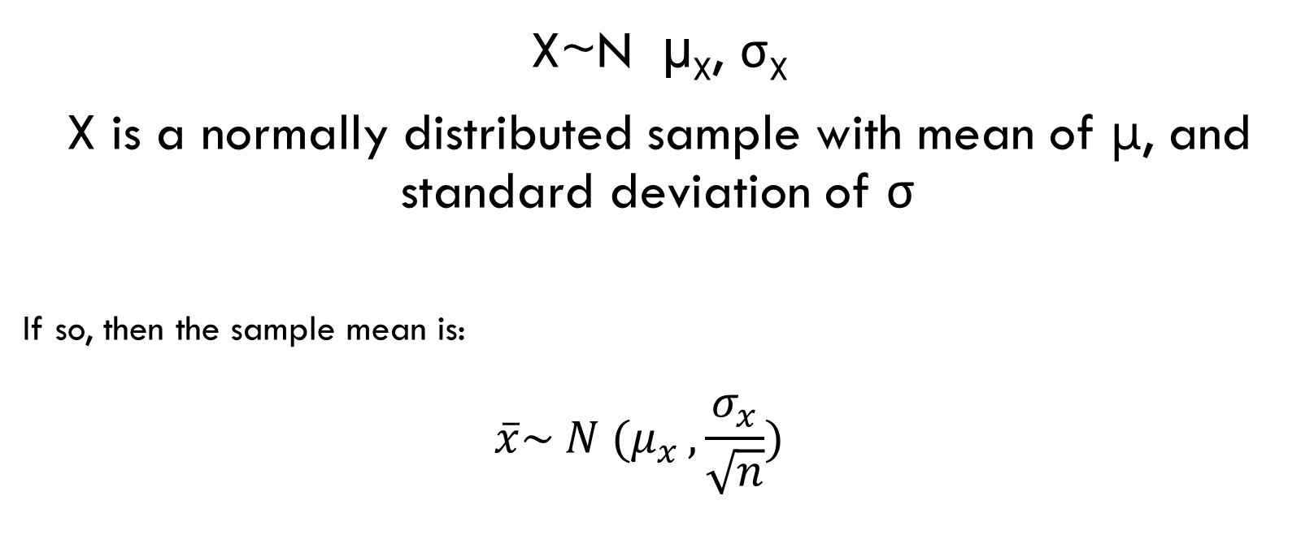
Case 1: Normally distributed sample
X~N µ_{X}, σ_{X}
X is a normally distributed sample with mean of μ, and standard deviation of σ
If so, then the sample mean is:
$$\overline{x}\sim N (μ_{x }, \frac{σ_{x}}{\sqrt{n}})$$

Slide 9
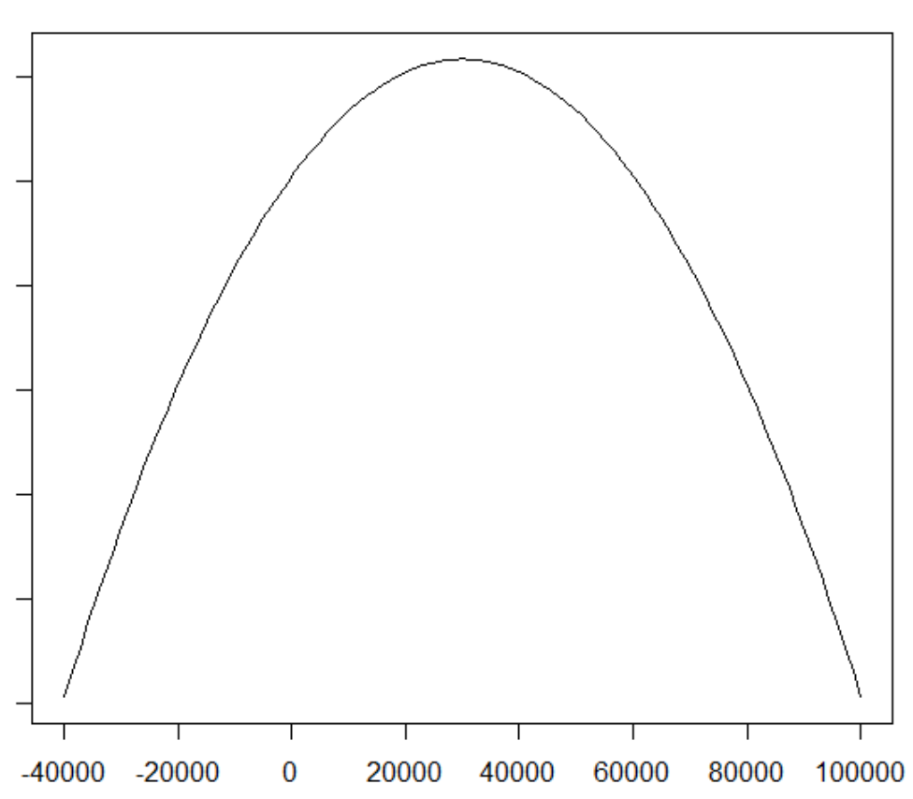
Example: Average income
Suppose that incomes are normally distributed with a population mean of $30,000 and a population standard deviation of $20,000.

Slide 10
What affects the precision of the sample mean?
The standard deviation of the sample mean is based upon:
The standard deviation of the population
The square root of the sample size

Slide 11
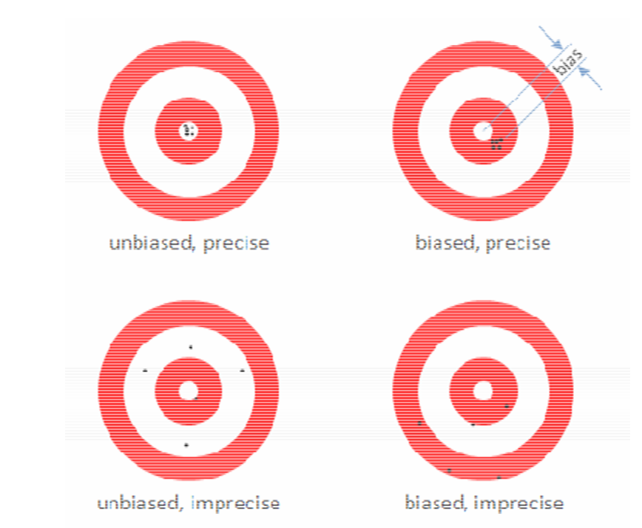

Slide 12
Is the sample mean unbiased?
Because the expected value or mean of the sampling distribution is the same as the population (what it is trying to estimate) it is unbiased.

Slide 13
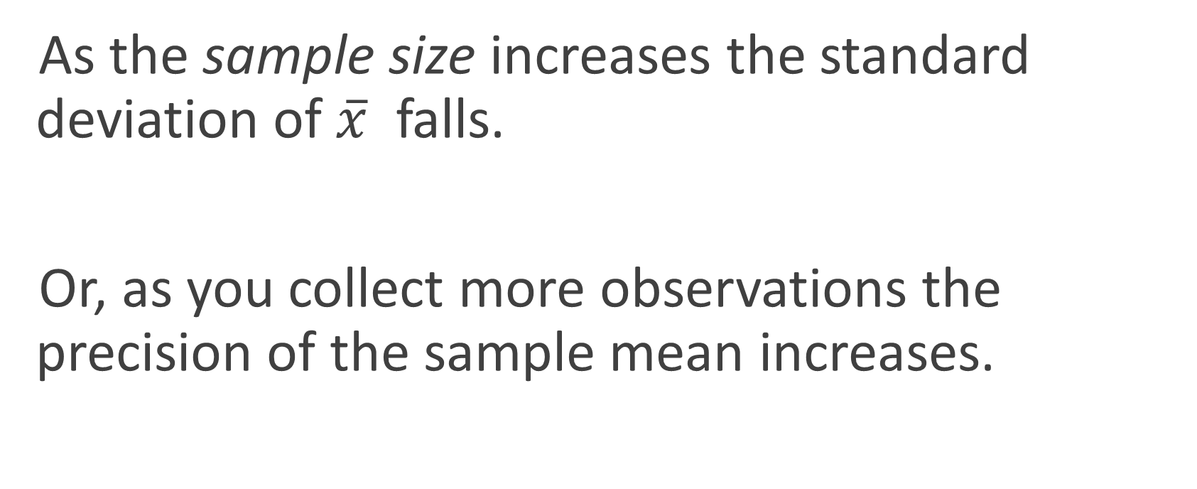
Sample size and precision
As the sample size increases the standard deviation of $\overline{x}$ falls.
Or, as you collect more observations the precision of the sample mean increases.

Slide 14
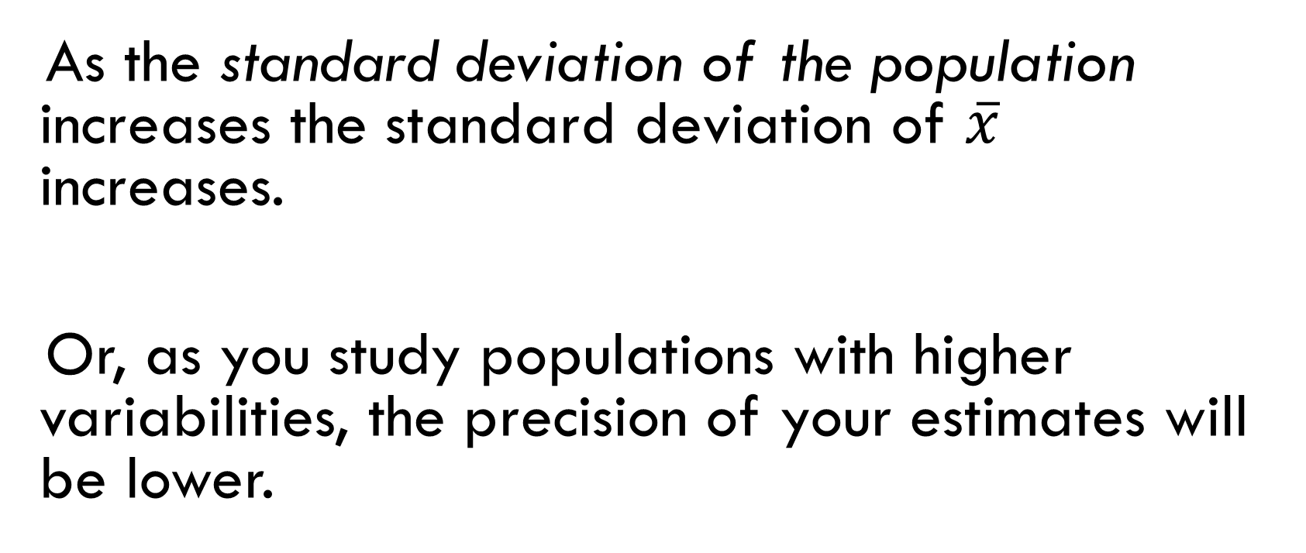
Population standard deviation and precision
As the standard deviation of the population increases the standard deviation of $\overline{x}$ increases.
Or, as you study populations with higher variabilities, the precision of your estimates will be lower.

Slide 15
Sample Mean – Non-Normally Distributed Sample

Slide 16
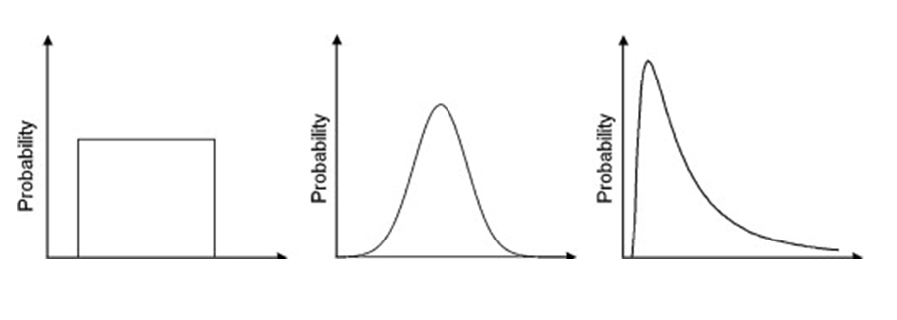
Case 2: NON-Normally distributed sample
Y~µY, σY

Slide 17
Central Limit Theorem
$$\lim_{n→∞}{P\left(\frac{S_{n}−nμ}{σ\sqrt{n}} ≤x\right)}= ϕ\left(x\right)$$

Slide 18
Central Limit Theorem
In other words, with a large enough sample the sampling distribution of the sample mean is normally distributed whether the sample comes from a normal distribution or not.
The neat part about this is that we don’t have to know anything about the distribution of the population.

Slide 19
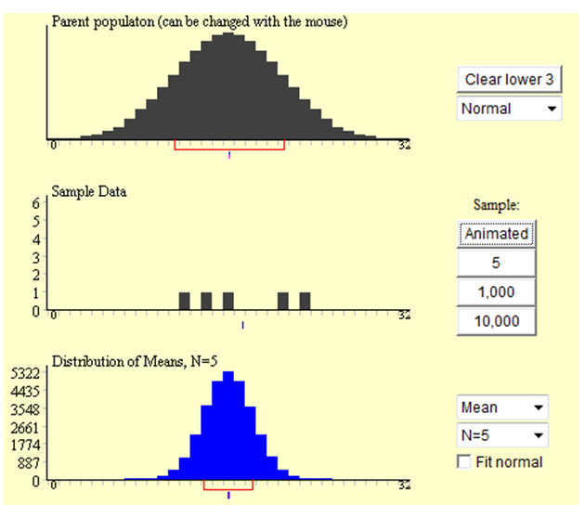
Example: Normal Population (n=5)

Slide 20
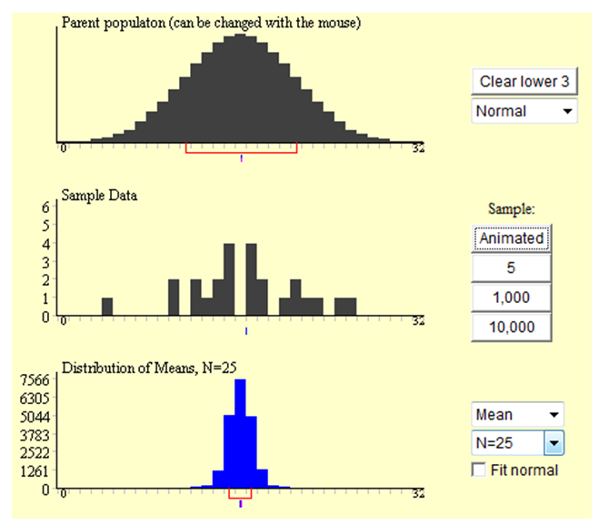
Example: Normal Population (n=25)

Slide 21
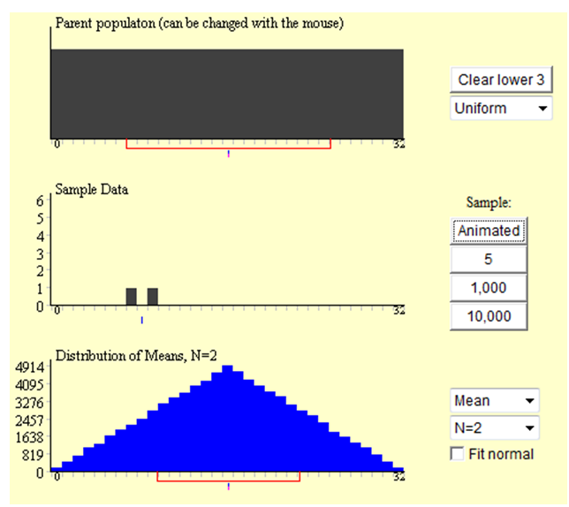
Example: Uniform Population (n=2)

Slide 22
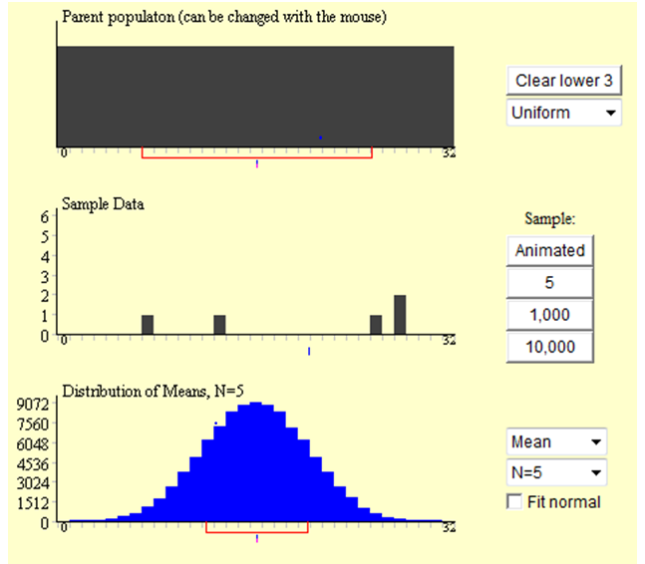
Example: Uniform Population (n=5)

Slide 23
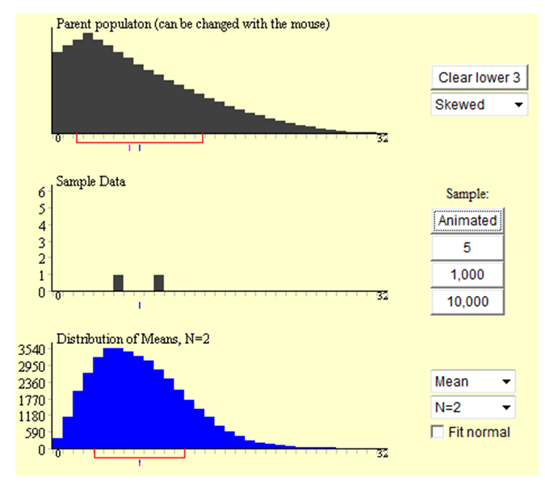
Example: Skewed Population (n=2)

Slide 24
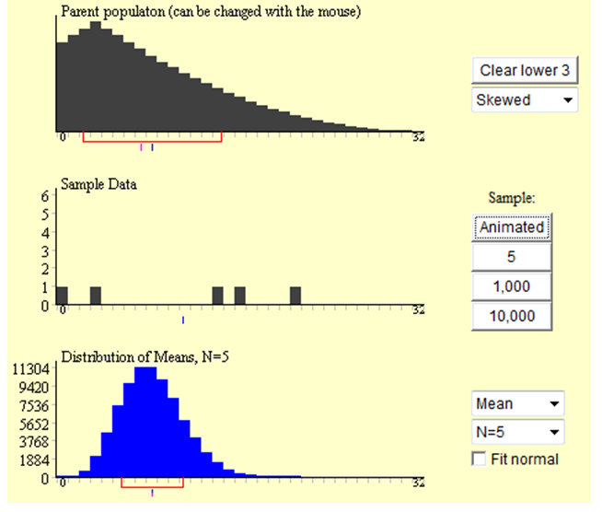
Example: Skewed Population (n=5)

Slide 25
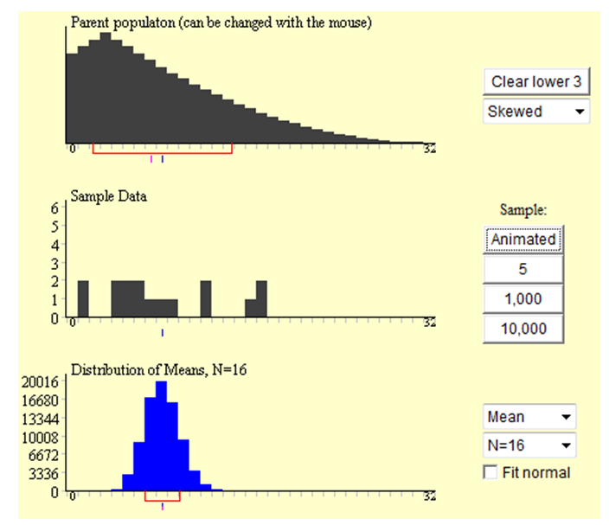
Example: Skewed Population (n=16)

Slide 26
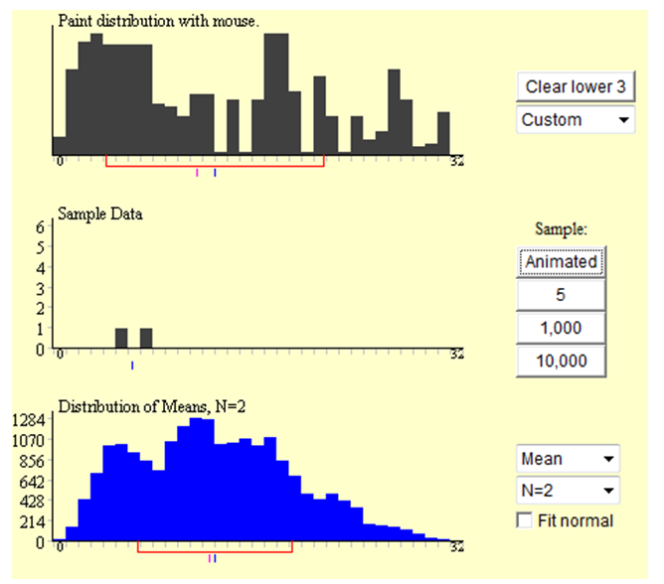
Example: Crazy Population (n=2)

Slide 27
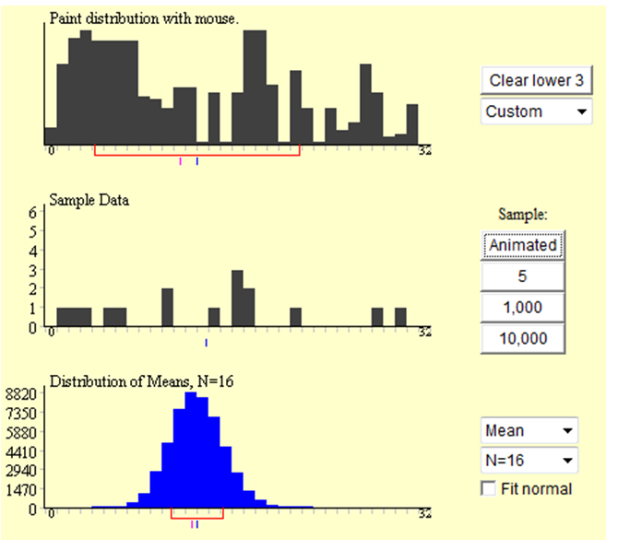
Example: Crazy Population (n=16)

Slide 28
T-Distribution

Slide 29
T-distribution
We have already pointed out that the sample mean is a random variable with the following distribution (assuming a reasonable sample size)
$\overline{x}\sim N (μ_{x }, \frac{σ_{x}}{\sqrt{n}})$
Therefore:
E(x) = $μ_{x }$
SD (x) = $\frac{σ_{x}}{\sqrt{n}}$

Slide 30
Standardizing the Sample Mean
Given that the sample mean is a random variable and we know its expected value and variance, we can standardize any particular realization of the sample mean:
$\frac{\overline{X }−E(\overline{X})}{SD (\overline{X})}= \frac{\overline{X}−μ_{X}}{\frac{σ_{x}}{\sqrt{n}}}=z \sim N(0,1)$
Because X is normally distributed, the standardized sample mean follows a standard normal distribution.

Slide 31
Example: Ages in Tacoma
Suppose that the true average age of people in Tacoma is 35 years and the standard deviation is 15 years.
How likely would it be to get a sample mean of 45 years or greater from a sample size of 25?

Slide 32
Example: Ages in Tacoma
Standardize this particular value of the sample mean:
$z=\frac{\overline{X}−μ_{X}}{\frac{σ_{x}}{\sqrt{n}}}= \frac{45−35}{\frac{15}{\sqrt{25}}}= \frac{10}{\frac{15}{5}}=3.33$
The sample mean is 3.33 standard deviations from the true mean, which implies that it is a very unlikely value for this population and sample size.

Slide 33
t-statistics
When we know $σ_{x}$
Then we have a “z” distribution
$\frac{\overline{X}−μ_{X}}{\frac{σ_{x}}{\sqrt{n}}}$
When we don’t know $σ_{x}$, we replace it with $s_{x}$ = $\frac{\sum{{\left(x_{i} − \overline{x}\right)}^{2}}}{n−1}$
This makes the distribution of the sample mean a “t” distribution
$\frac{\overline{X}−μ_{X}}{\frac{s_{x}}{\sqrt{n}}} \sim t(n−1)$

Slide 34
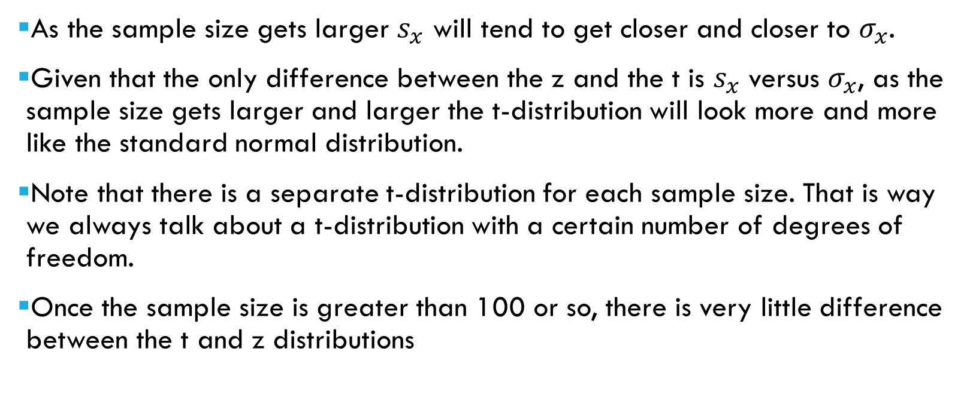
Relationship between the t and Normal distributions
As the sample size gets larger $s_{x}$ will tend to get closer and closer to $σ_{x}$.
Given that the only difference between the z and the t is $s_{x}$ versus $σ_{x}$, as the sample size gets larger and larger the t-distribution will look more and more like the standard normal distribution.
Note that there is a separate t-distribution for each sample size. That is way we always talk about a t-distribution with a certain number of degrees of freedom.
Once the sample size is greater than 100 or so, there is very little difference between the t and z distributions

Slide 35
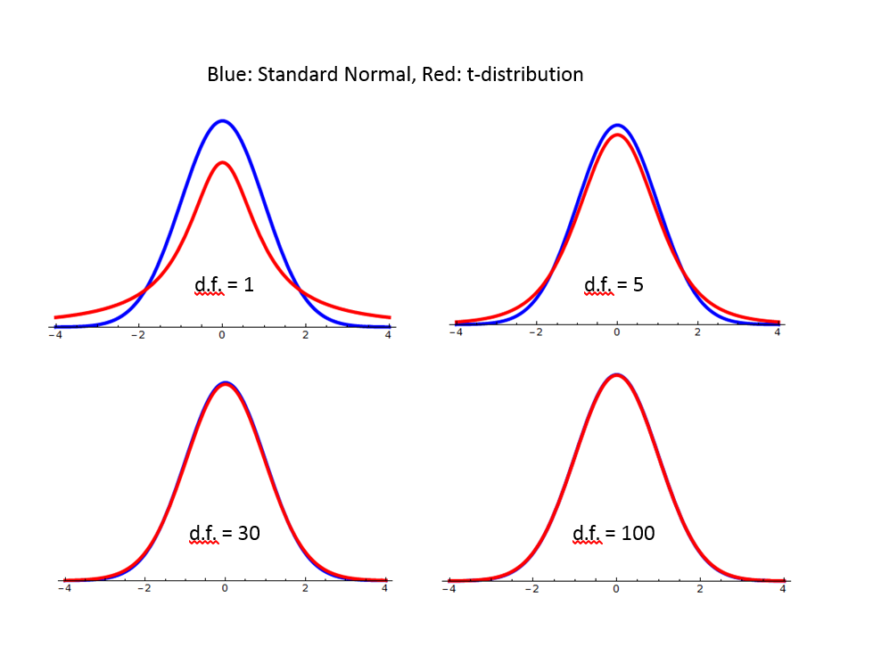

Slide 36
Fun fact about t-distributions
The t-distribution, also known as Student’s t-distribution was published in Biometrika in 1908 by a Guinness beer worker, chemist, statistician, William Sealy Gosset, who was interested in small sample size calculations, specifically for choosing types of barley with the highest yield.

Slide 37
Confidence Intervals

Slide 38
Confidence Intervals
A confidence interval is a range of values where we think the true value is located with some level of confidence.
The confidence level is set by the researcher. The most common level is 95%.
The level of significance (α) is 100% minus the confidence level.
So if the level of significance is 5% then the confidence level is 95%.
α: level of significance
(1-α): confidence level

Slide 39
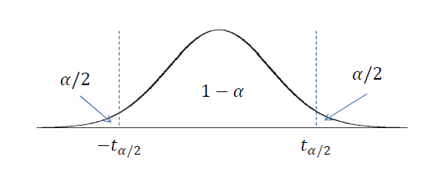
Confidence Intervals for Averages
The margin of error for the sample average is:
$t_{α/2}\left(\frac{s_{x}}{\sqrt{n}}\right)$
$where t_{α/2}$:

Slide 40
Example: Average Income Tacoma
Suppose that you wanted to estimate the average income of residents in Tacoma. You collect a random sample of 100 people. Your estimate is $40,000 with a sample standard deviation of $30,000.
Construct a confidence interval for the estimate of the true average income of Tacoma residents.

Slide 41
Example: Average Income Tacoma
From the question:
n =
100
sx =
$30,000
How do we find tα/2?
First, unless you are told differently , assume α = 5%.
The degrees of freedom is the sample size minus one,
n − 1 = 100 − 1 = 99

Slide 42
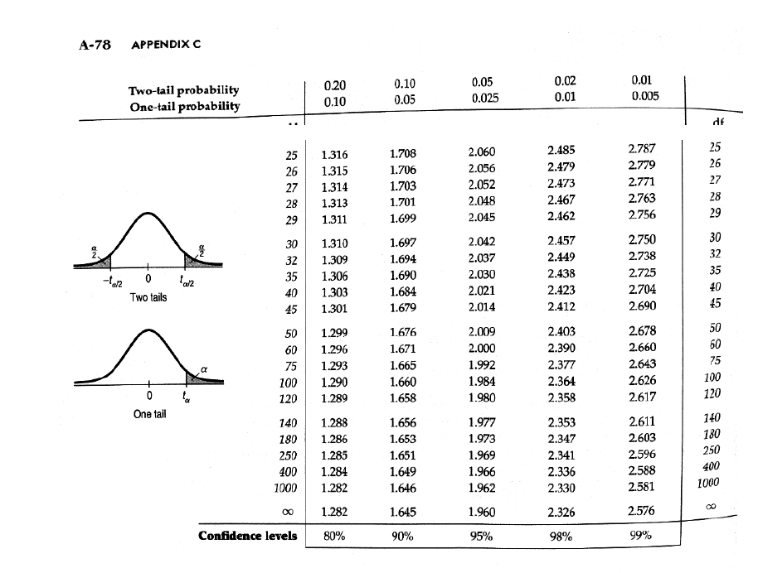

Slide 46
Example: Tacoma Average Income
Confidence Interval
X ± $t_{α/2}\left(\frac{s_{x}}{\sqrt{n}}\right)$
=
40,000± 1.984$\left(\frac{\$30,000}{\sqrt{100}}\right)=$
40,000± 1.984$\left(\frac{\$30,000}{10}\right)=$

Slide 47
Example: Tacoma Average Income
= $40,000 ± 1.984 * $3,000
= $40,000 ± $5,952
$34,048 to $45,952

Slide 48
What affects the width of the confidence interval?
X ± $t_{α/2}\left(\frac{s_{x}}{\sqrt{n}}\right)$
The sample size: as n increases, the width will decrease.
The standard deviation of the data: as $s_{x}$ increases the width will increase.
The level of significance: as α increases, the confidence level will decrease. This means the width will decrease.

Slide 49
Hypothesis Testing

Slide 50
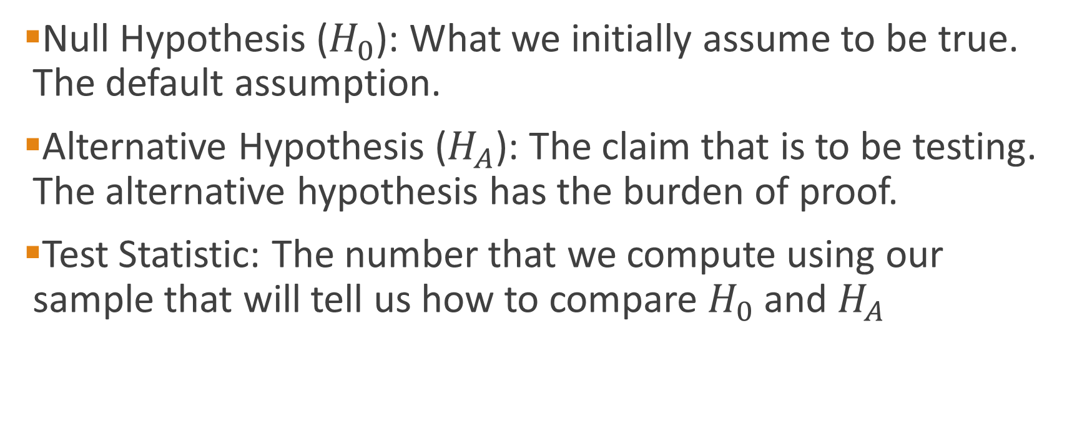
Hypothesis Testing
Null Hypothesis ($H_{0}$): What we initially assume to be true. The default assumption.
Alternative Hypothesis ($H_{A}$): The claim that is to be testing. The alternative hypothesis has the burden of proof.
Test Statistic: The number that we compute using our sample that will tell us how to compare $H_{0}$ and $H_{A}$

Slide 51
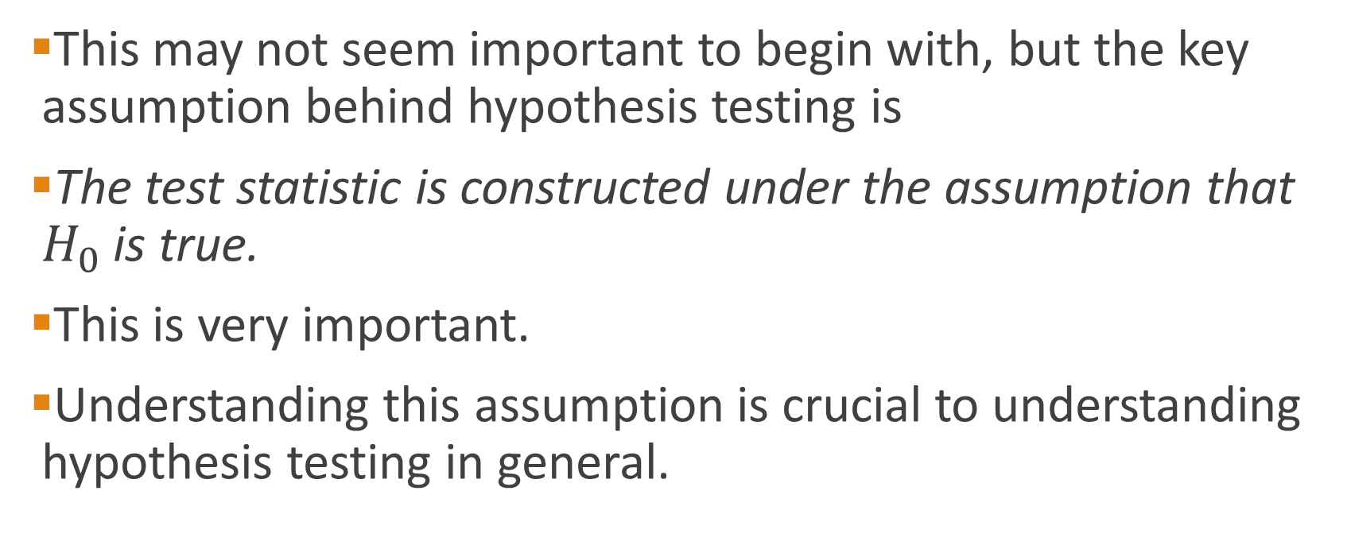
Hypothesis Testing
This may not seem important to begin with, but the key assumption behind hypothesis testing is
The test statistic is constructed under the assumption that $H_{0}$ is true.
This is very important.
Understanding this assumption is crucial to understanding hypothesis testing in general.

Slide 52
A. Rejection Region Method:
Divide the distribution into rejection and non-rejection regions
Defines the unlikely values of the sample statistic if the null hypothesis is true, the critical value(s)
Defines rejection region of the sampling distribution
Rejection region(s) is designated by α , (level of significance)
Typical values are .01, .05, or .10
α is selected by the researcher at the beginning
α provides the critical value(s) of the test

Slide 53
Rejection Region or Critical Value Approach:
Level of significance = α
Non-rejection region
Represents
critical value
a
H₀: μ = 12 H₁: μ ≠ 12
a
/2
/2
Two-tail test
0
H₀: μ ≤ 12 H₁: μ > 12
a
Rejection region is shaded
Upper-tail test
0
H₀: μ ≥ 12 H₁: μ < 12
a
Lower-tail test
0

Slide 54
Test of Hypothesis for the Mean
σ known
σ Unknown
The test statistic is:
The test statistic is:

Slide 55
Steps to Hypothesis Testing
State the H₀ and H₁ clearly
Identify the test statistic (two-tail, one-tail, and Z or t distribution
Depending on the type of risk you are willing to take, specify the level of significance,
Find the decision rule, critical values, and rejection regions. If –CV<actual value (sample statistic) <+CV, then do not reject the H₀
Collect the data and do the calculation for the actual values of the test statistic from the sample

Slide 56
Steps to Hypothesis testing, continued
Make statistical decision
Do not Reject H₀
Reject H₀
Conclude H₀ may be true
Conclude H₁ is “true”
(There is sufficient evidence of H1)
Make management/business/administrative decision

Slide 57
When do we use a two-tail test? when do we use a one-tail test?
The answer depends on the question you are trying to answer.
A two-tail is used when the researcher has no idea which direction the study will go, interested in both direction. (example: testing a new technique, a new product, a new theory and we don’t know the direction)
A new machine is producing 12 fluid once can of soft drink. The quality control manager is concern with cans containing too much or too little. Then, the test is a two-tailed test. That is the two rejection regions in tails is most likely (higher probability) to provide evidence of H_{1.}
12

Slide 58
One-tail test is used when the researcher is interested in the direction.
Example: The soft-drink company puts a label on cans claiming they contain 12 oz. A consumer advocate desires to test this statement. She would assume that each can contains at least 12 oz and tries to find evidence to the contrary. That is, she examines the evidence for less than 12 0z.
What tail of the distribution is the most logical (higher probability) to find that evidence? The only way to reject the claim is to get evidence of less than 12 oz, left tail.
11.5
12
14

Slide 59
Example: Ages of MBA students
Historically MBA students in the United States have had an average age 30 years old.
It appears that this year MBA students are older that in past years.
A random sample of 100 students was taken and the average age was 32 with a sample standard deviation of 6 years.
Is there enough evidence to say that this years MBA students are older than in past years?

Slide 60
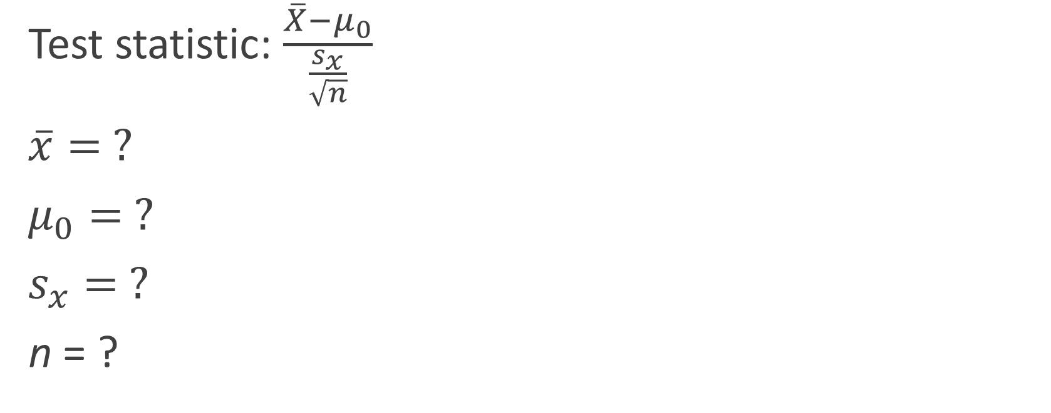
Example: MBA Ages
Test statistic: $\frac{\overline{X}−μ_{0}}{\frac{s_{x}}{\sqrt{n}}}$
$\overline{x}= ?$
$μ_{0}= ?$
$s_{x}= ?$
n = ?
Notes:
X bar = 32
Mu nought = 30
S x = 6
N = 100

Slide 61
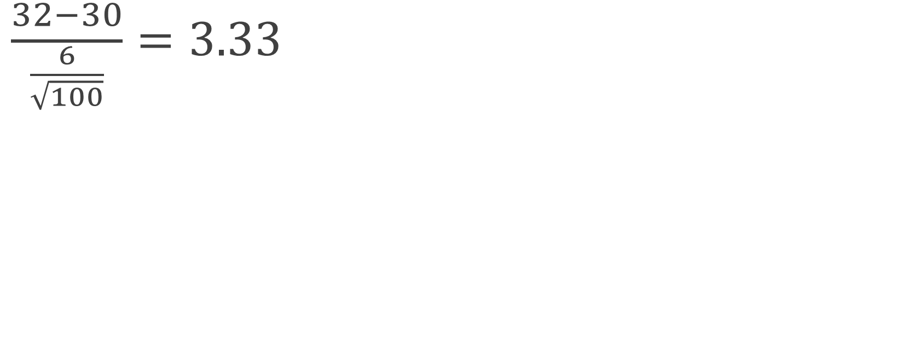
Example: MBA Ages
$\frac{32−30}{\frac{6}{\sqrt{100}}}=3.33$

Slide 62
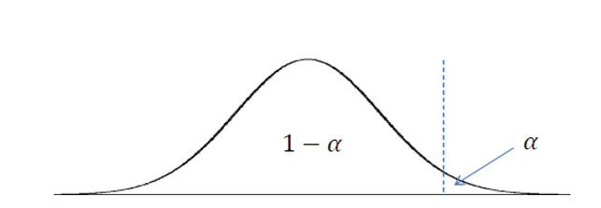
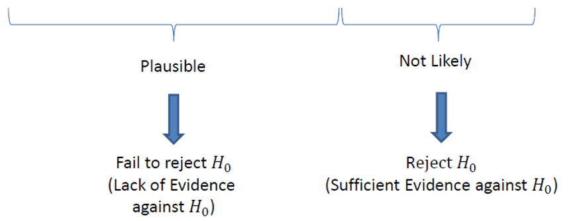

Slide 63
t (99) = 1.66

Slide 64

$$3.33$$
t (99) = 1.66

Slide 65
$$3.33$$
t (99) = 1.66

Slide 66
Type I and Type II Error

Slide 67
Type I and II Errors:
The size of α , the rejection region, affects the risk of making different types of incorrect decisions.
Type I Error
Rejecting a true null hypothesis when it should NOT be rejected
Considered a serious type of error
The probability of Type I Error is α
It is also called level of significance of the test
Type II Error
Fail to reject a false null hypothesis that should have been rejected
The probability of Type II Error is β

Slide 68
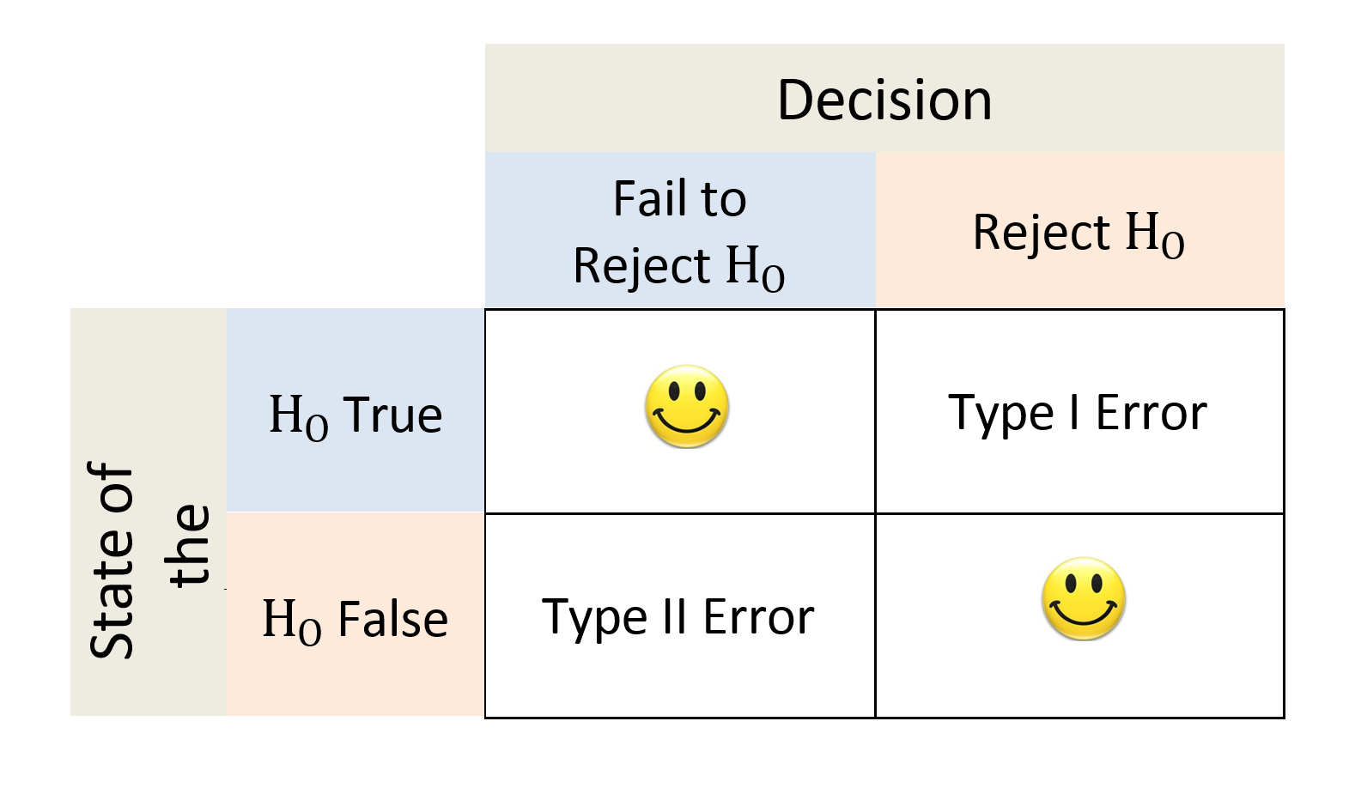

Slide 69
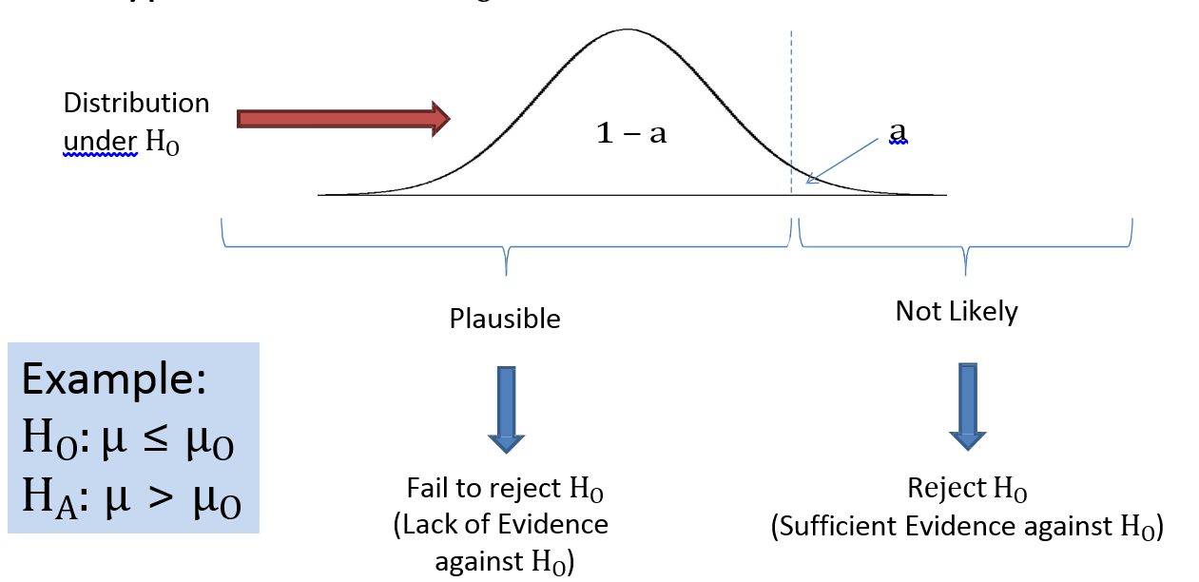
What are the chances of a Type I error?

Slide 70
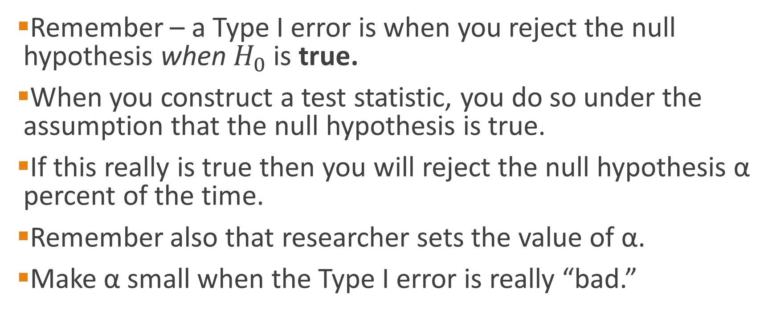
Type I Error
Remember – a Type I error is when you reject the null hypothesis when $H_{0}$ is true.
When you construct a test statistic, you do so under the assumption that the null hypothesis is true.
If this really is true then you will reject the null hypothesis α percent of the time.
Remember also that researcher sets the value of α.
Make α small when the Type I error is really “bad.”

Slide 71
What are the chances of a Type II error?

Slide 72
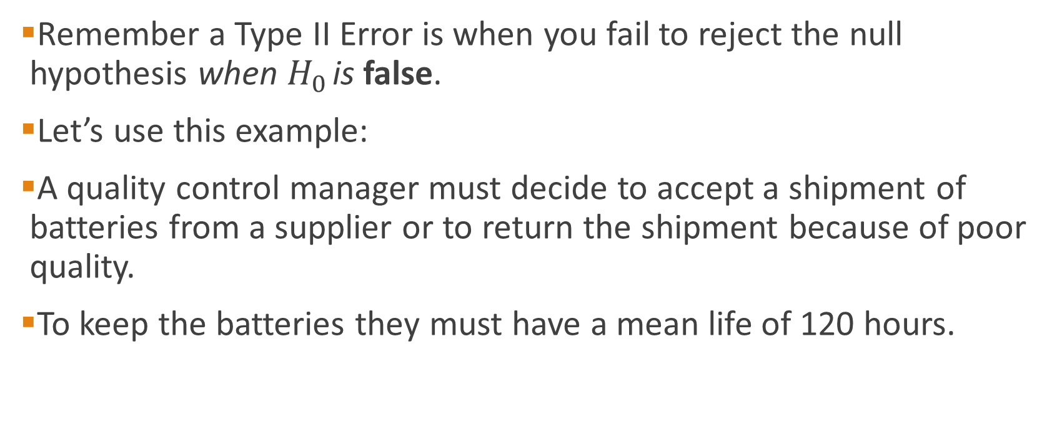
What are the chances of a Type II error?
Remember a Type II Error is when you fail to reject the null hypothesis when $H_{0}$ is false.
Let’s use this example:
A quality control manager must decide to accept a shipment of batteries from a supplier or to return the shipment because of poor quality.
To keep the batteries they must have a mean life of 120 hours.

Slide 73
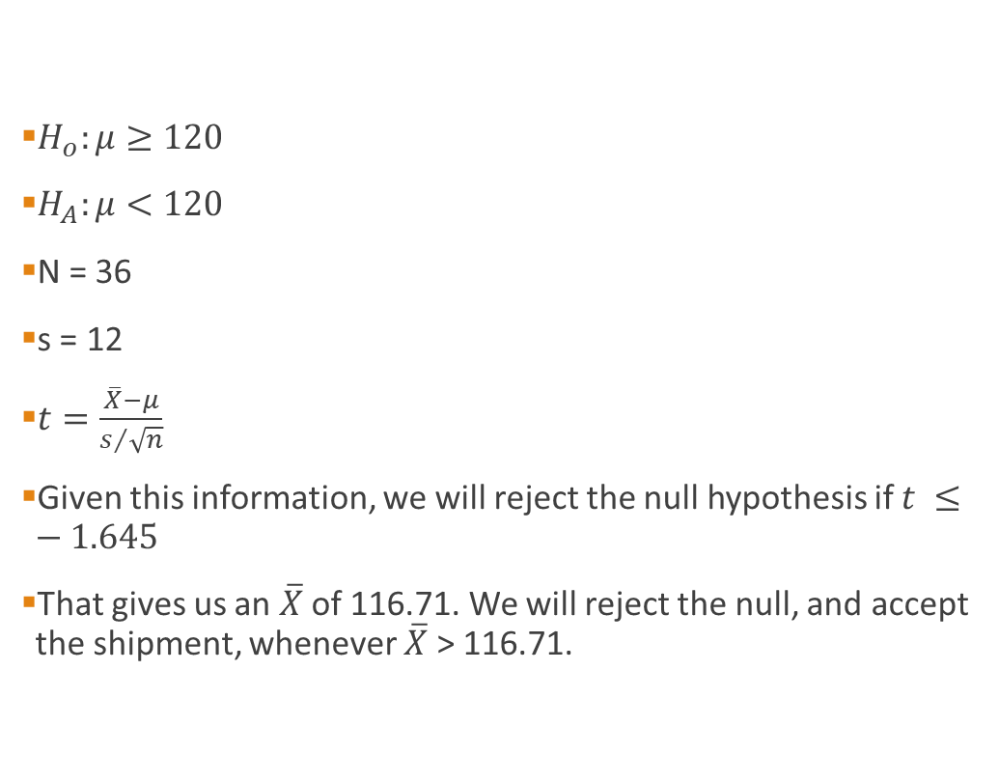
What are the chances of a Type II error?
$H_{o}:μ≥120$
$H_{A}:μ<120$
N = 36
s = 12
$t=\frac{\overline{X}−μ}{s/{\sqrt{n}}}$
Given this information, we will reject the null hypothesis if $t ≤−1.645$
That gives us an $\overline{X}$ of 116.71. We will reject the null, and accept the shipment, whenever $\overline{X}$ > 116.71.

Slide 74
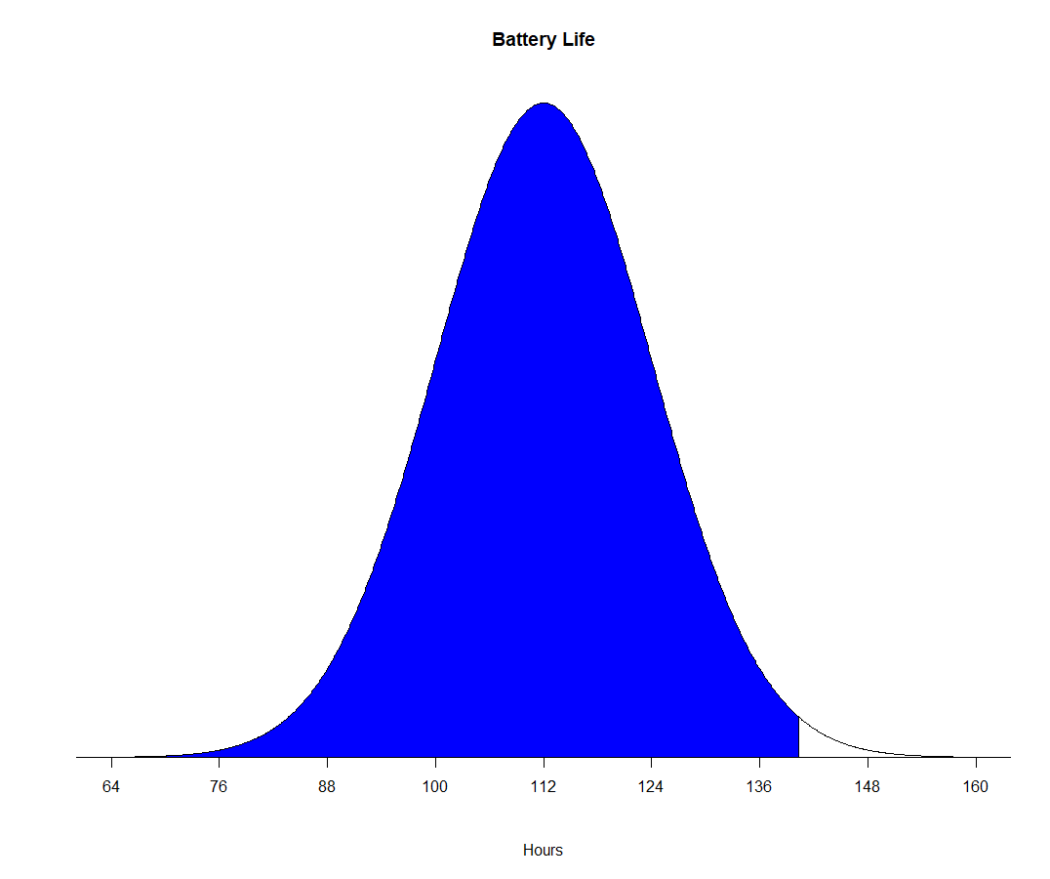

What are the chances of a Type II error?
By selecting different values of μ, we can calculate the probability of falsely rejecting the null, and committing a Type II error.
If μ = 112, then the probability that the sample mean is greater than 116.71 is
$t=\frac{116.71−112}{{12}/{\sqrt{36}}}=2.36$
P = .0091
This is the probability of making a Type II error

Slide 75
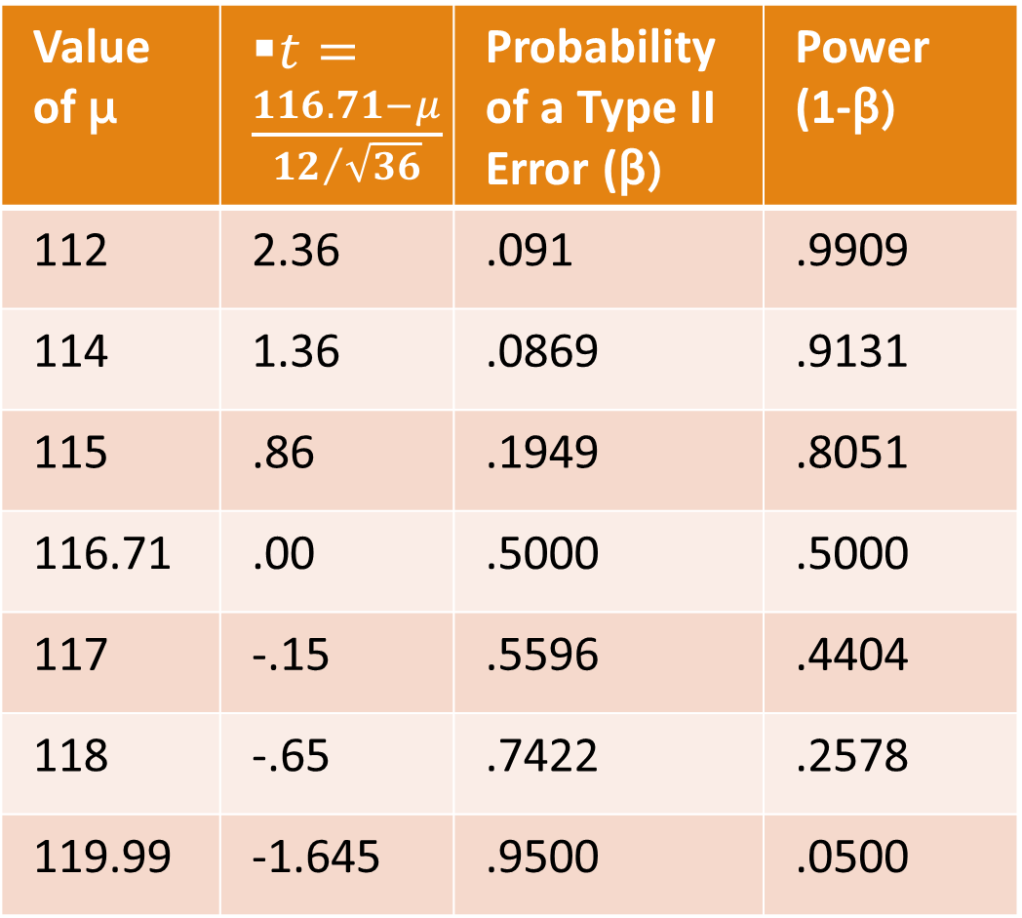
Probability of making a Type II error with different values of the Mean
Value of μ | $t=\frac{116.71−μ}{{12}/{\sqrt{36}}}$ | Probability of a Type II Error (β) | Power (1-β)
112 | 2.36 | .091 | .9909
114 | 1.36 | .0869 | .9131
115 | .86 | .1949 | .8051
116.71 | .00 | .5000 | .5000
117 | -.15 | .5596 | .4404
118 | -.65 | .7422 | .2578
119.99 | -1.645 | .9500 | .0500

Slide 76
Power Curve
Probability of correctly rejecting H₀ when it is false is called the power of the test.
The graph of the power for each value of μ is called a power curve.
The height of the power curve indicates the probability of correctly rejecting Ho when it is false.

Slide 77
Picking the Null Hypothesis
Sometimes it is not clear what the null hypothesis should be.
You should always pick the null hypothesis such that the Type I Error is the worse of the two possible errors.
You do this because by changing α, you can control the probability of a Type I Error occurring.

Slide 78

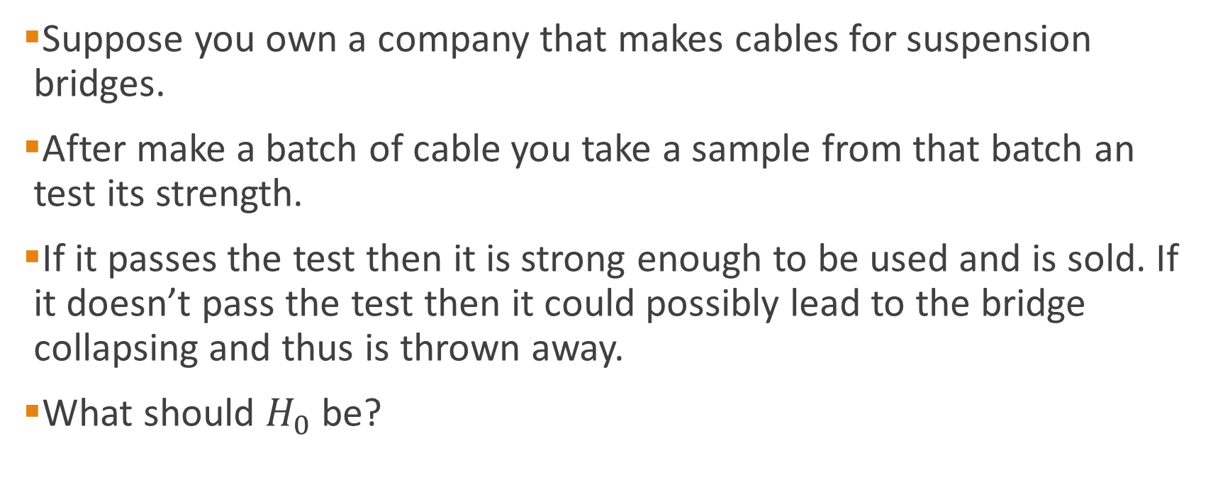
Example: Bridge Cable
Suppose you own a company that makes cables for suspension bridges.
After make a batch of cable you take a sample from that batch an test its strength.
If it passes the test then it is strong enough to be used and is sold. If it doesn’t pass the test then it could possibly lead to the bridge collapsing and thus is thrown away.
What should $H_{0}$ be?

Slide 79
Example: Bridge Cable
The two possible errors are
Selling defective cable.
Throwing away flawless cable.
If you really don’t want to kill people then you should set the null hypothesis to the cable being defective.
The Type I error in that case is saying the cable is okay when it really isn’t. By setting a to be very small, you can make the chances of cause a bridge failure small.
In other words, because you care about human life you will assume the cable is defective until there is sufficient evidence to convince you otherwise.

Slide 80
Type I and Type II errors cannot happen at the same time
Type I error can only occur if H₀ is true
Type II error can only occur if H₀ is false
There is a tradeoff between type I and II errors. If the probability of type I error ( α ) increased, then the probability of type II error ( β ) declines.
When the difference between the hypothesized parameter and the actual true value is small, the probability of type two error (the non-rejection region) is larger.
Increasing the sample size, n, for a given level of α, reduces β

Slide 81
Hypothesis Testing
Other Methods

Slide 82
Hypothesis Testing – Confidence Intervals

Slide 83
Confidence intervals and hypothesis testing
There is an extremely close relationship between confidence intervals and hypothesis testing.
When a 95% confidence interval is constructed, all values in the interval are considered plausible values for the parameter being estimated.
Values outside the interval are rejected as relatively implausible. If the value of the parameter specified by the null hypothesis is contained in the 95% interval then the null hypothesis cannot be rejected at the 0.05 level.
If the value specified by the null hypothesis is not in the interval then the null hypothesis can be rejected at the 0.05 level. If a 99% confidence interval is constructed, then values outside the interval are rejected at the 0.01 level.

Slide 84
Confidence intervals and hypothesis testing
Any time the parameter specified by a null hypothesis is not contained in the 95% confidence interval estimating that parameter, the null hypothesis can be rejected at the 0.05 level or less.
Similarly, if the 99% interval does not contain the parameter then the null hypothesis can be rejected at the 0.01 level.
The null hypothesis is not rejected if the parameter value specified by the null hypothesis is in the interval since the null hypothesis would still be plausible.

Slide 85
Example – Confidence Interval Hypothesis Testing
CCN and ActMedia Provided a television channel targeted to individuals waiting in supermarket checkout lines. The channel showed news, short features, and advertisements. The length of the program was based on the assumption that the population meantime a shopper stand in a supermarket checkout line is 8 minutes. A sample of actual waiting times will be used to test assumption and determine whether actual mean waiting time differs from this standard.
A sample of 120 shoppers showed a sample mean waiting time of 8.4 minutes. Assuming a standard deviation of σ=3.2 minutes compute a 95% confidence interval for the population mean and determine whether this supports your conclusion.

Slide 86
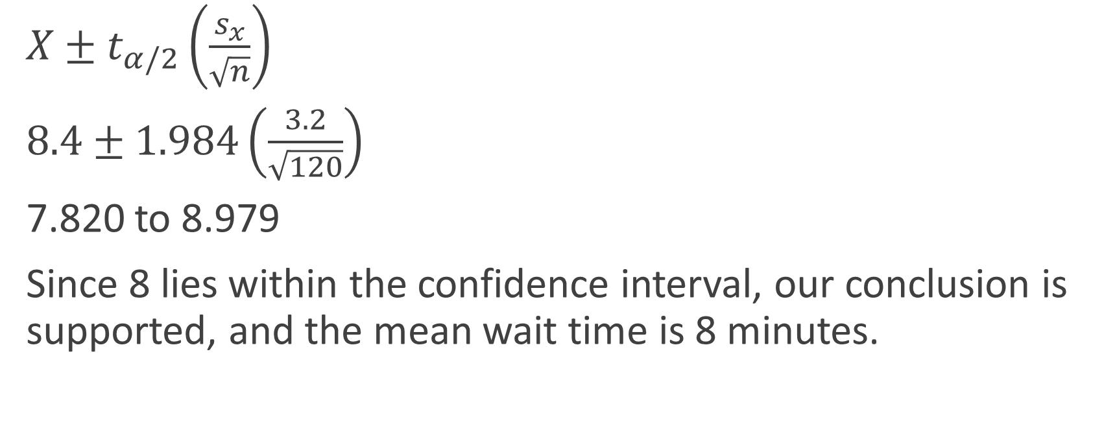
Example – Confidence Interval Hypothesis Testing
$X±t_{α/2}\left(\frac{s_{x}}{\sqrt{n}}\right)$
$8.4±1.984\left(\frac{3.2}{\sqrt{120}}\right)$
7.820 to 8.979
Since 8 lies within the confidence interval, our conclusion is supported, and the mean wait time is 8 minutes.

Slide 87
Summary – Hypothesis Testing with CI
If the interval contains your null then the null hypothesis cannot be rejected at the stated level of confidence. If the interval does not contain your null then the null hypothesis can be rejected.

Slide 88
Hypothesis Testing – p-Value Method

Slide 89
P-Value Approach –
P-value=Max. Probability of (Type I Error), calculated from the sample.
Given the sample information what is the size of blue are?
H₀: μ = 12 H₁: μ ≠ 12
Two-tail test
0
H₀: μ ≤ 12 H₁: μ > 12
Upper-tail test
0
H₀: μ ≥ 12 H₁: μ < 12
0

Slide 90
B. P-Value approach to Hypothesis Testing:
The rejection region approach allows you to examine evidence but restrict you to not more than a certain probability (say α = 5%) of rejecting a true H₀ by mistake.
The P-value approach allows you to use the information from the sample and then calculate the maximum probability of rejecting a true H₀ by mistake.
Another way of looking at P-value is the probability of observing a sample information of “A=11.5” when the true population parameter is “12=B”. The P-value is the maximum probability of such mistake taking place.

Slide 91
That is to say that P-value is the smallest value of α for which H₀ can be rejected based on the sample information
Convert Sample Statistic (e.g., sample mean) to Test Statistic (e.g., Z statistic )
Obtain the p-value from a table or computer
Compare the p-value with α
If p-value < α , reject H₀
If p-value ≥ α , do not reject H₀

Slide 92
What does “Statistical Significance” mean?
Saying an event is statistically significant means that it is unlikely to have occurred by chance.
For example it is usually safe to assume that a coin is “fair” in that after tossing a coin, the probability of getting a head or tail is the same.
Suppose you toss the coin 20 times and each time it turns up tails. While this is possible, it is very unlikely to have happened by chance.
This would lead you to reject the assumption that the coin is fair.
Saying something is statistically significant is the same as saying that the null hypothesis is rejected.

Slide 93
What is a p-value?
The probability, computed assuming that H₀ is true, that the test statistic would take a value as extreme or more extreme than that actually observed is called the P-value of the test. The smaller the P-value is, the stronger the evidence is against data.
When doing research, we normally set the acceptable level for the P-value before the study. This is called the level of significance. Common levels of significance are a = 0.05 or a = 0.01 depending on the importance or cost.
If the P-value computed from our data is less than the level of significance, then we say our results are significant at the 0.05 or 0.01 level. For example, a P-value of 0.17 is NOT significant at the 0.05 nor the 0.01 level.

Slide 94
p-value
A p-value is the probability of obtaining a result that is at least extreme as the one observed assuming the null hypothesis is true.
Remember that we reject the null hypothesis when the test statistic is unlikely if the null is true.
Therefore, we reject the null hypothesis when the p-value is small.
A small p-value is the same as a result being statistically significant.

Slide 95
Example
You read in a newspaper that the mean SAT score of the nation’s high school graduates is 500 with a standard deviation of 110. You think that UWT freshmen have higher SAT scores on average than that of the nation’s high school graduates. To find out, you randomly select 100 UWT freshmen and find out their SAT scores. On average, they have an SAT score of 533.

Slide 96

Example
First, find the z-score:

Slide 97
Example
Now look up the z-score of your sample mean in the table of z-scores to find out what percentage of the standard normal distribution falls between your sample z-score and positive infinity (since you’re doing an upper tailed test—i.e., your alternative hypothesis is that the mean UWT freshmen SAT score is greater than the mean of the null hypothesis). You do this and find out:
p(z > 3) = .0013

Slide 98
Example
Thus the p-value for your sample is: p=.0013
Since the smallest alpha level you could have used and still rejected the null hypothesis with this sample is .0013.

Slide 99
What the p-value is not
The p-value is not the probability that the null hypothesis is true.
The p-value is not the probability that a finding is "merely a fluke.“
The p-value is not the probability of falsely rejecting the null hypothesis.
The p-value is not the probability that a replicating experiment would not yield the same conclusion.

